Slide 1
Fiber Nonlinearity and Modeling
Optical Communications Networks
Spring 2021

Slide 2
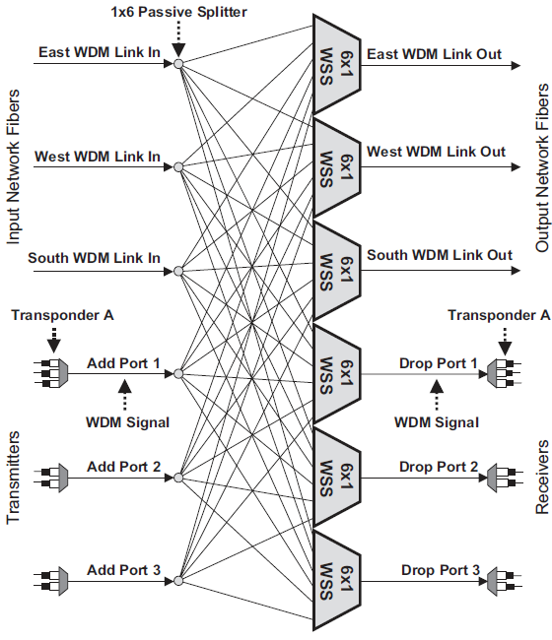
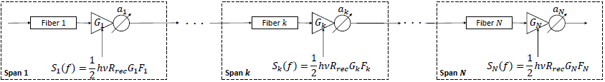
Physical topology of optical networks

Slide 3
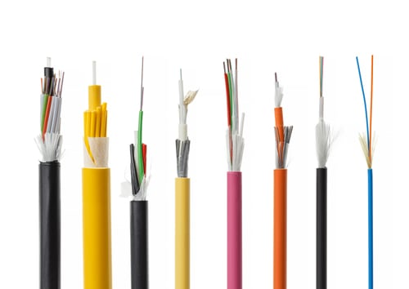
Optical fiber
An electromagnetic propagation media
First manufactured of copper, then silica
Imposing impairments on transmitted signal

Slide 4
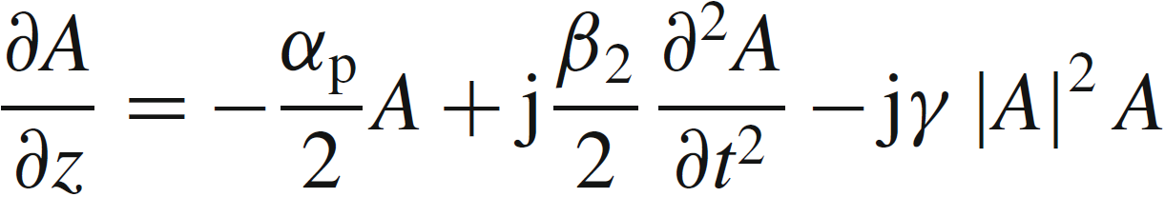
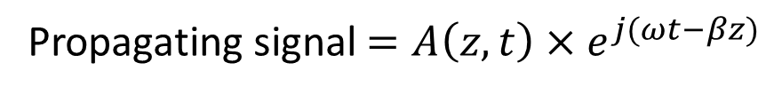
NLSE, a full description of optical fiber
Propagating signal$=A\left(z,t\right)×e^{j(ωt−βz)}$
Attenuation
Signal power loss
Dispersion (GVD)
Caused by dependence of fiber refractive index to frequency
Signal temporal spreading
Non-linear effect
Caused by dependence of fiber refractive index to power
Signal spectrum spreading

Slide 5
Duality between dispersion and non-linear effect
Dispersion
Interaction between different times
Phase rotation in frequency
Easy to analyze! ☺
Non-linear effect
Interaction between different frequencies
Phase rotation in time
Hard to analyze! ☹
Phase rotation due to the non-linear effect is called SPM. We also have other non-linear terms. More on this later…

Slide 6
Amplified spontaneous emission
Excitation of electrons due to photon absorption
Originated at active elements
Mostly modeled as a Gaussian phenomena
Linear impact on signal

Slide 7
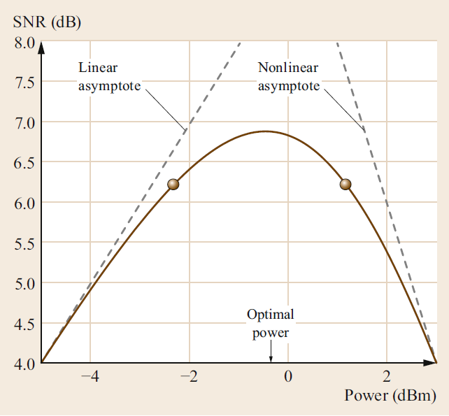
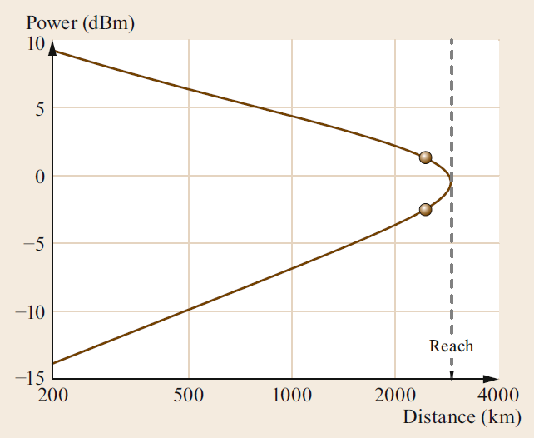
SNR and optical reach
Example of behavior SNR versus power after
a fiber-optic link
Example of optimum power versus distance at fixed SNR

Slide 8
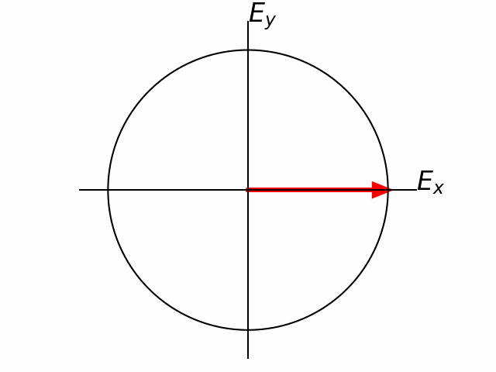
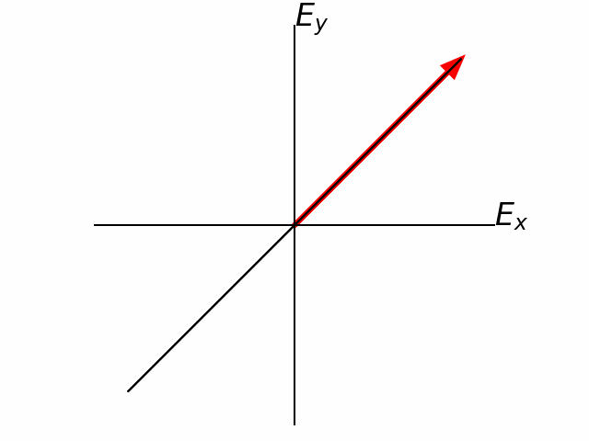
Other contributions to NLSE
Accounting for dual-polarized propagation
Fiber birefringence
Polarization variation through fiber
Typically fast in space (~meters)
Periodic over a beat length
Matrix-form attenuation and dispersion

Slide 9
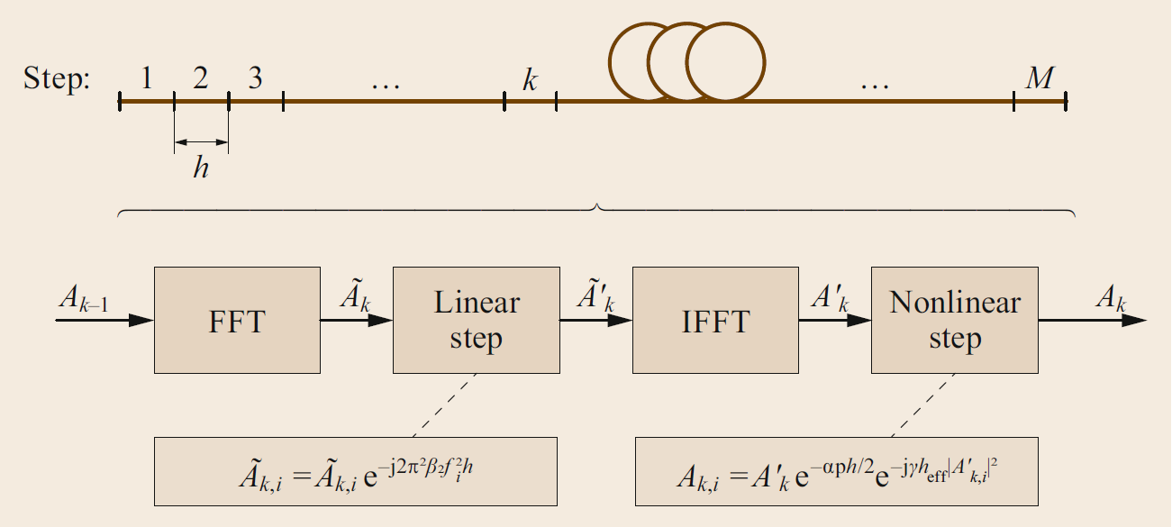
Fiber propagation: numerical methods
Split-step Fourier method (SSFM)

Slide 10
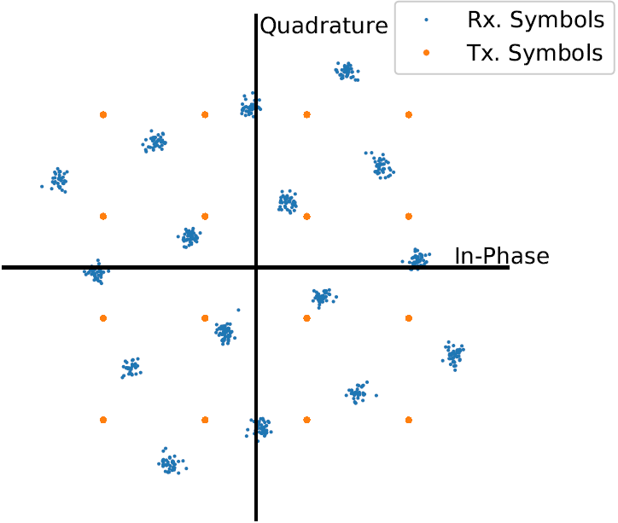
Non-linear phase rotation

Slide 11
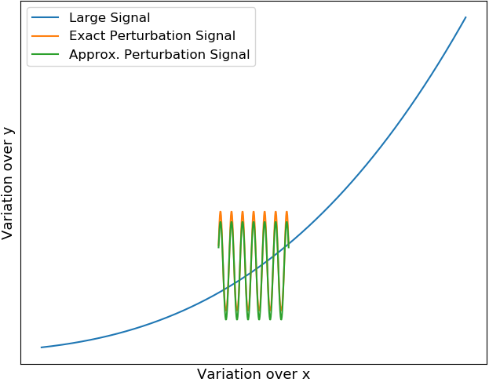
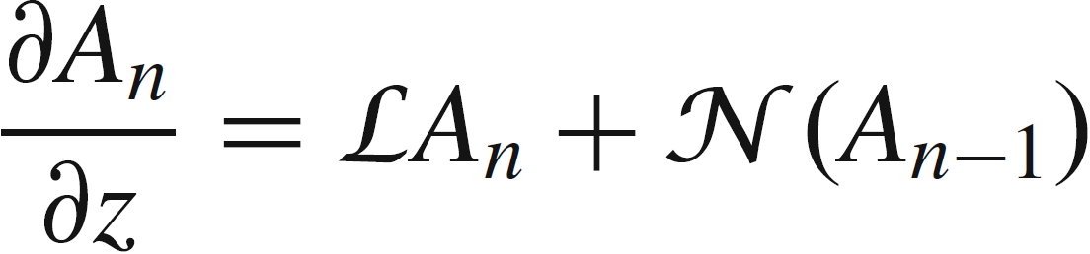
Fiber propagation: analytical perturbation modeling
Negligible non-linear perturbation around a large-scale signal
No major deviation from working point
Based on Taylor’s expansion
Fair to high accuracy for strongly dispersive fiber-optic systems
Accounting only for 1st-order non-linear effects
Enter the XPM and FWM!

Slide 12
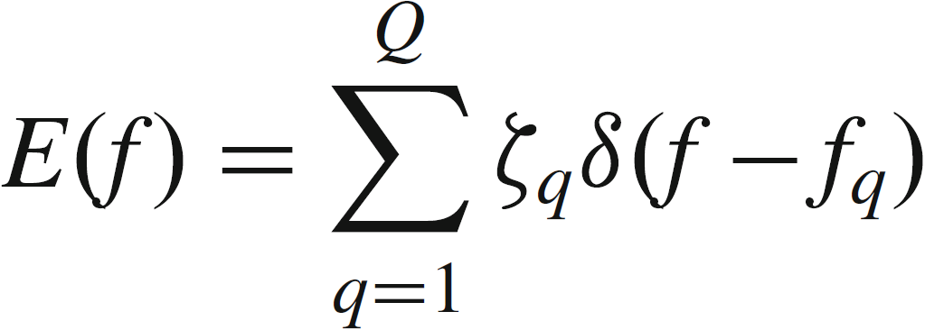
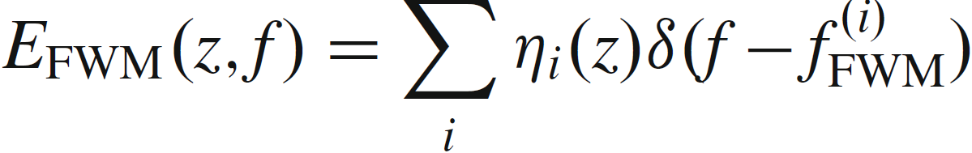
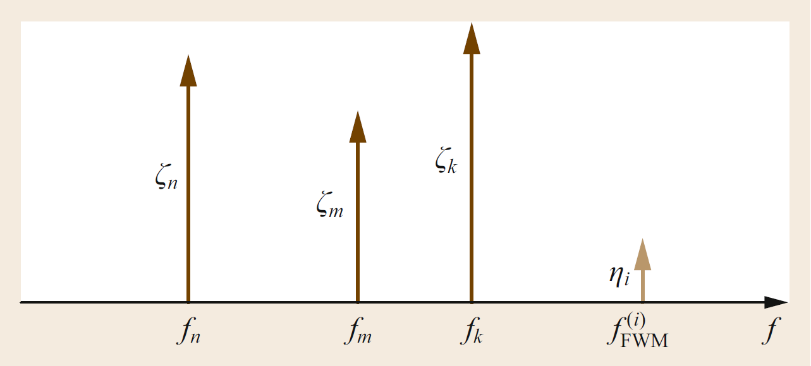
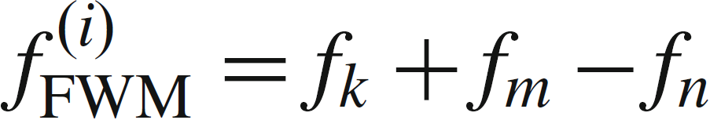
Fiber propagation: analytical perturbation modeling (cont’d)
<< Solving Manakov equation >>
Optical Fiber

Slide 13
Dispersion compensated vs. uncompensated likns
Dispersion-compensated links
Performed at the end of each link or span
Fiber-grating dispersion-compensating module (FBG-DCM)
Minimal to no compensation at receiver
Dispersion-uncompensated links
Performed at the coherent transceivers
Feasible thanks to DSP
Capable of more non-linear mitigation due to time-domain signal spreading
A suitable framework for non-linear models derivations

Slide 14

Non-linear models for fiber propagation: the GN model
Input Signal
Optical Fiber
Output Signal
ASE Gaussian Noise
$$≡$$
Input Signal
Optical Fiber
Output Signal
NLI Gaussian Noise
ASE Gaussian Noise

Slide 15
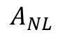
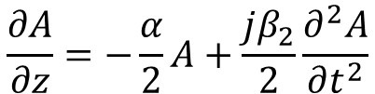
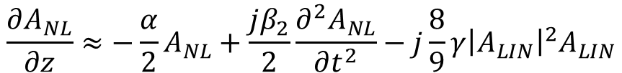
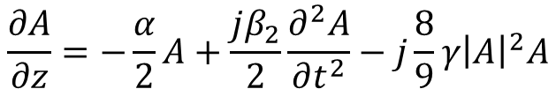
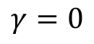
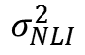
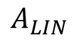
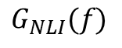
Non-linear models for fiber propagation: roadmap
$$\frac{∂A}{∂z}=−\frac{α}{2}A+\frac{jβ_{2}}{2}\frac{∂^{2}A}{∂t^{2}}−j\frac{8}{9}γ{\left|A\right|}^{2}A$$
$$γ=0$$
$$\frac{∂A}{∂z}=−\frac{α}{2}A+\frac{jβ_{2}}{2}\frac{∂^{2}A}{∂t^{2}}$$
$$A_{LIN}$$
Perturbation Approach
$$Non−linear part= −j\frac{8}{9}γ{\left|A\right|}^{2}A≈−j\frac{8}{9}γ{\left|A_{LIN}\right|}^{2}A_{LIN}$$
$$\frac{∂A_{NL}}{∂z}≈−\frac{α}{2}A_{NL}+\frac{jβ_{2}}{2}\frac{∂^{2}A_{NL}}{∂t^{2}}−j\frac{8}{9}γ{\left|A_{LIN}\right|}^{2}A_{LIN}$$
Derivation Details
$$A_{NL}$$
$$G_{NLI}(f)$$
$$σ_{NLI}^{2}$$

Slide 16
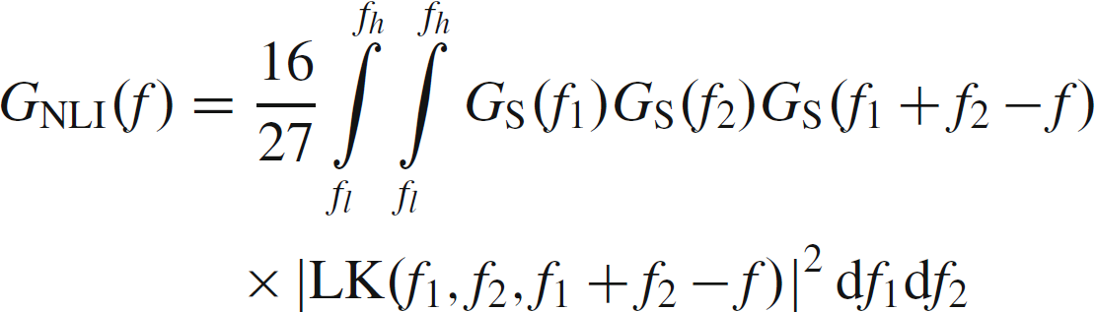
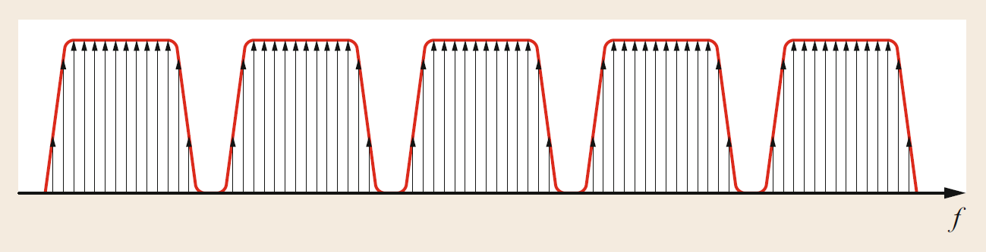
GN model: discrete to continuous

Slide 17
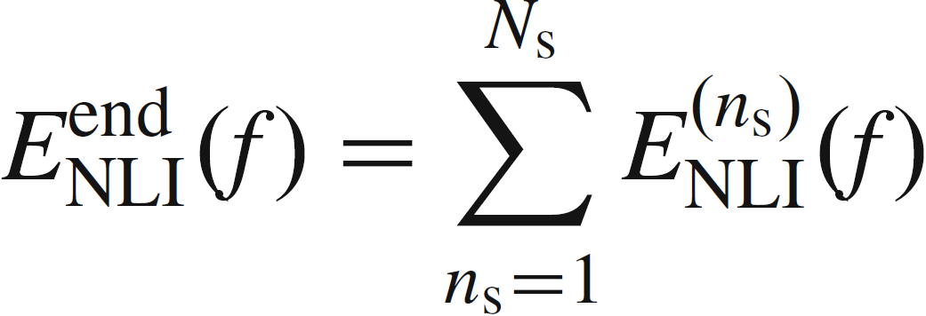
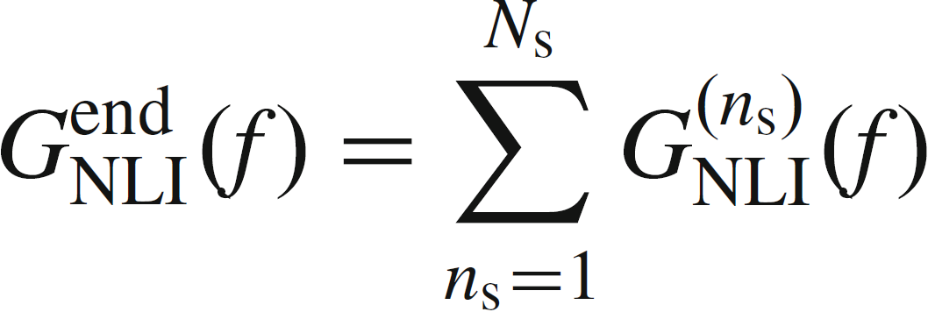
Applying GN model to multiple spans (incoherent)
Spans may have different spectrums!
The NLI noise is accumulated incoherently.
Dispersion is not compensated before the receiver.
NLI
NLI
NLI
Linear
+
Linear
+
Linear

Slide 18
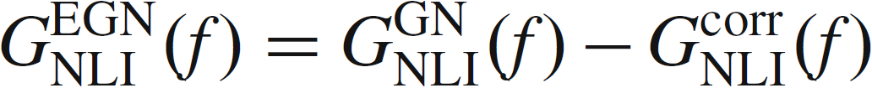
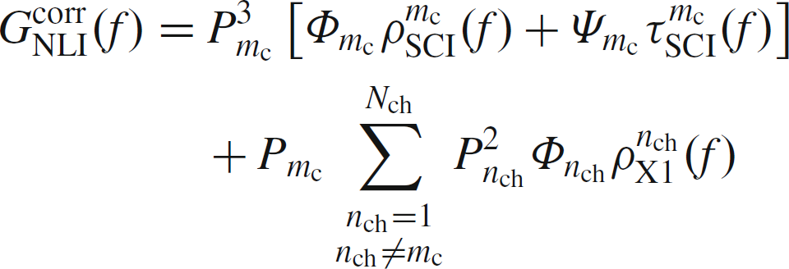
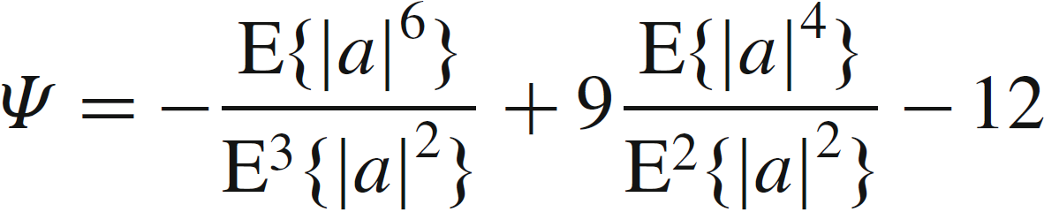
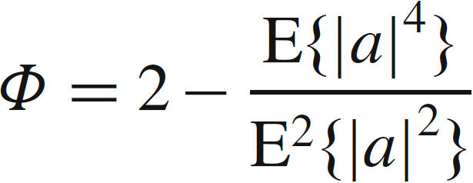
Corrections to GN model: the EGN model
The GN model is fairly accurate when,
the symbol rate is large,
fiber dispersion is large,
loss per span is not too small,
amplification is prevalently lumped and
the number of traversed spans is sufficiently large.
This model overestimates NLI. Enhanced GN (EGN) model is a way out…
GN model is modulation independent, while EGN model is not.
Better analysis can be performed on new NLI terms SCI, XCI and MCI (in addition to SPM, XPM and FWM)

Slide 19
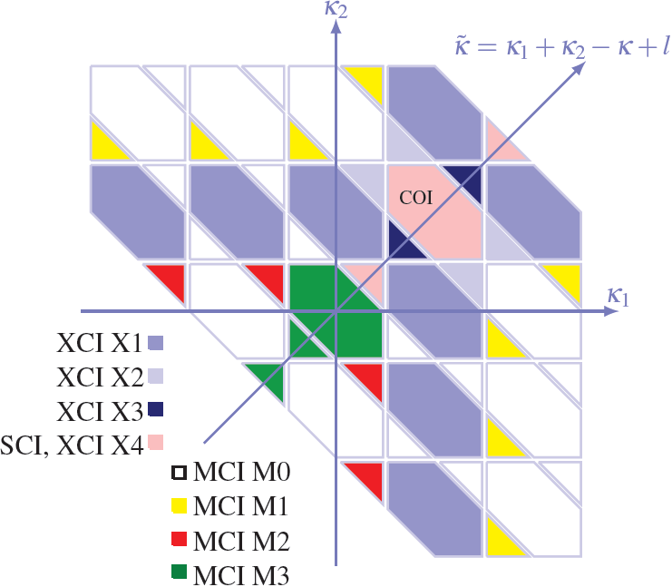
NLI terms: SCI, XCI and MCI

Slide 20
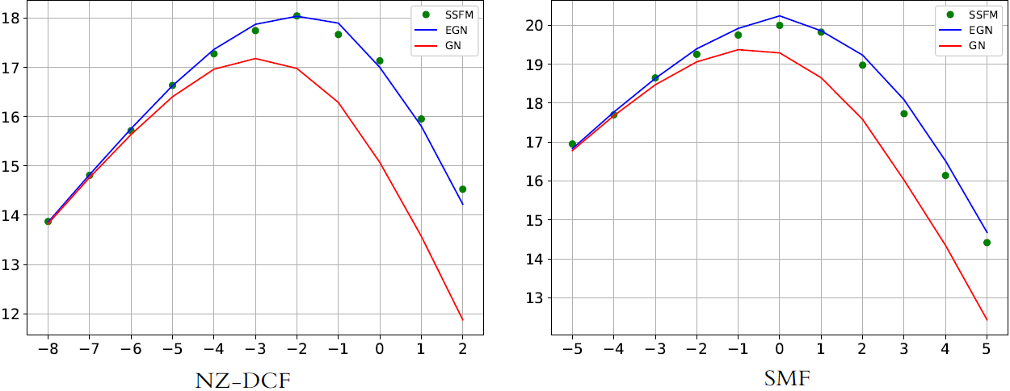
GN and EGN models accuracy comparison

Slide 21
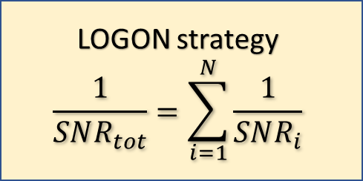
Employing models for PLI-aware optimization
Routing, modulation and spectrum assignment (RMSA)
Allocation of available network resources (such as spans spectrums, modulation format and power) to demands
First model applications including locally-optimal globally-optimal Nyquist (LOGON) strategy
Traditionally investigated in full-load scenario (where links spectrums are fully occupied)
Over-simplification by decoupling traffic pattern from NLI
Making lightpaths insensitive to new connections
Too pessimistic and sub-optimal!
LOGON strategy
$$\frac{1}{SNR_{tot}}=\sum_{i=1}^{N}{\frac{1}{SNR_{i}}}$$

Slide 22
Employing Models for PLI-Aware Optimization (cont’d)
A 2nd application in RMSA
Using stochastic processing
Bounded probability of incorrectness
A 3rd application in RMSA
Using models for machine-learning-based approaches
Training a neural network based on positive and negative examples of feasible lightpaths

Slide 23
Outlook toward the future of physical-layer models
More efficient non-linear mitigation through more complicated affordable DSP operations
Model simplification for optimization problems (in both static and dynamic cases)
Model generalization and development to novel applications (such as multi-mode fibers or higher-dimension modulation formats)
Accurate investigation of ASE and NLI interaction (important in low-SNR regime)

